Slide 1

CSC384 Tutorial 9101

Slide 2
CSC384: Intro to Artificial Intelligence
Tutorial9101 Thursdays 9:10-10AM

Slide 3

Welcome CSC384!
My name is Kristina! Facts about me:
I love Cats!
This is my first time TAing so please bear with me :’D
My email is kristina.todic@mail.utoronto.ca
Feel free to contact me if you have any questions, I will try my best to reply back :)

Slide 4

What we’re gonna be doing today
Going to put you in breakout groups
Attempt the questions given in the handout
We’ll come back and go through the solutions together.

Slide 5
Please Attempt Q1 (both part 1 and 2) and we’ll be back in 10 minutes.

Slide 6
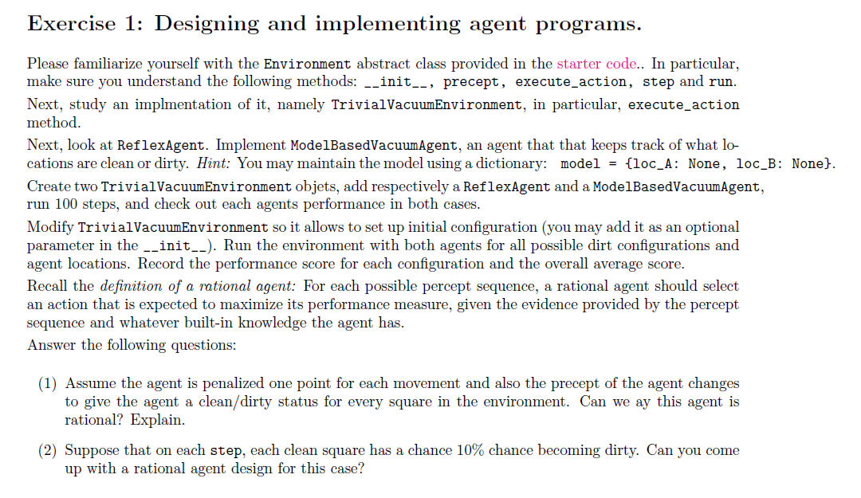

Slide 7
Driver navigator time
Model based vacuum
I will be driver and you can be navigator
Type in chat or just shout out next step!

Slide 8
Implementing ModelBasedVacuumAgent
def ModelBasedVacuumAgent():
"""An agent that keeps track of what locations are clean or dirty."""
model = {loc_A: None, loc_B: None}
def program(percept):
location, status = percept
model[location] = status
if model[loc_A] == model[loc_B] == 'Clean':
return 'Stay'
elif status == 'Dirty':
return 'Suck'
elif location == loc_A:
return 'Right'
elif location == loc_B:
return 'Left'
return Agent(program)
Model Based Agents need to store a model of the environment. We will make our model a dictionary with the keys being locations in the environment and the values as status of location. Initially the status is None but our agent will update the model with each step.
Updating the model with info from current precept
Checking current state of environment including parts unobservable by current precept but have been observed in previous precepts
Condition-action rules exactly the same as in simple reflex agent

Slide 9
Let’s Discuss!
The Question: Assume the agent is penalized one point for each movement and also the precept of the agent change to give the agent a clean/dirty status for every square in the environment. Can we say this agent is rational?
Definition to Remember:
Rational Agent: For each possible percept sequence, a rational agent should select an action that is expected to maximize its performance measure, given the evidence provided by the percept sequence and whatever built-in knowledge the agent has.

Slide 10
Solution
In this case, a simple reflex agent can be perfectly rational. The agent can consist of a table indexed by percept, that species an action to take for each possible state. After the agent acts, the world is updated and the next percept will tell the agent what to do next. For larger environments, constructing a table is infeasible. Instead, the agent could run an optimal search algorithm and execute the first step of the solution sequence. Again, no internal state is required, but it would help to be able to store the solution sequence instead of recomputing it for each new percept.

Slide 11
Let’s Discuss!
Q: Suppose that on each step, each clean square has a chance 10% chance becoming dirty. Can you come up with a rational agent design for this case?

Slide 12
Solution
In this case, the agent must keep touring the squares indefinitely. The probability that a square is dirty increases monotonically with the time since it was last cleaned, so the rational strategy is, roughly speaking, to repeatedly execute the shortest possible tour of all squares. (We say \roughly speaking" because there are complications caused by the fact that the shortest tour may visit some squares twice, depending on the geography.)

Slide 13
Can there be more than one agent program that implements a given agent function?
Give an example,
or show why one is not possible

Slide 14
Answer
Yes! Take any agent program and insert null statements that do not affect the output.

Slide 15
Are there agent functions that cannot be implemented by any agent program?

Slide 16
Answer
Yes; the agent function might specify that the agent print true when the percept is a Turing machine program that halts, and false otherwise.
(Note: in dynamic environments, for machines of less than innite speed, the rational agent function may not be implementable; e.g., the agent function that always plays a winning move, if any, in a game of chess.)

Slide 17
Given a fixed machine architecture, does each agent program implement exactly one agent function?

Slide 18
Answer
Yes; the agent's behavior is fixed by the architecture and program.

Slide 19
Given an architecture with n bits of storage, how many different possible agent programs are there?

Slide 20
Answer
There are 2^{n} agent programs, although many of these will not run at all.
(Note: Any given program can devote at most n bits to storage, so its internal state can distinguish among only 2^{n} past histories. Because the agent function specifies actions based on percept histories, there will be many agent functions that cannot be implemented because of lack of memory in the machine.)

Slide 21
Suppose we keep the agent program fixed but speed up the machine by a factor of two. Does that change the agent function?

Slide 22
Answer
It depends on the programand the environment. If the environment is dynamic, speeding up the machine may mean choosing different (perhaps better) actions and/or acting sooner. If the environment is static and the program pays no attention to the passage of elapsed time, the agent function is unchanged.

Slide 23
Need clarification?
Email me or ask on piazza and I will try my best to explain :)

